Slide 1


(Statistical) Reaction Rate Theories
School on Kinetics and Dynamics of Chemical Reactions
Emilio Martínez Núñez
Departamento de Química Física
Universidade of Santiago de Compostela
SPAIN
emilio.nunez@usc.es
(Statistical) Reaction Rate Theories

Slide 2
Contents
Conventional Transition State Theory (CTST or TST)
Statistical Formulation
Thermodynamic Formulation
Partition Functions
Symmetry and Statistical Factors
Discussion of the Main Assumptions
Improvements and Extensions
Variational Transition State Theory (VTST)
Tunneling Corrections
Reactions with Several Conformers
Further Reading
(Statistical) Reaction Rate Theories
Notes:
At the end of this section, I will present a summary of the main assumptions of transition state theory, and this will open the door to talk about improvements and extension. We will see the fundamentals of variational TST, tunneling corrections and, I will end this section talking about reactions in which reactants and TSs have several conformers.

Slide 3
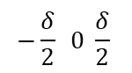
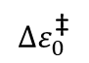
Transition State Theory^{1,2} Statistical Formulation
Basic postulates
Molecular systems that cross the critical dividing surface in the direction of products do not return (no-recrossing approximation).
During the reaction, the molecular states of reactants follow a Maxwell-Boltzmann distribution (at a given T).
The complexes crossing the dividing surface towards products have a Maxwell-Boltzmann distribution of energies (at T).
In the TS, motion along the reaction coordinate may be separated from the rest of modes and treated as a classical translation.
v_{s}
Potential energy
$$Δε_{0}^{\text{‡}}$$
ZPE
Reactants
Products
$$−\frac{δ}{2} 0 \frac{δ}{2}$$
Reaction coordinate, s
In conventional TST, the dividing surface passes through the TS and is orthogonal to the reaction coordinate.
H. Eyring, J. Chem. Phys. 3, 107 (1935).
M. G. Evans and M. Polanyi, Trans. Faraday Soc. 31, 875 (1935).
(Statistical) Reaction Rate Theories
Notes:
Reactants and products are separated by a critical dividing surface located at the TS.
We consider that this surface has a very, very small width of length delta.
This ${∆ε}_{0}^{\text{‡}}$ is the reaction barrier, including ZPE corrections.
Postulate 3 is sometimes considered as a consequence of postulate 2.
In the TS, motion... Notice that this motion is a kind of relative motion.

Slide 4
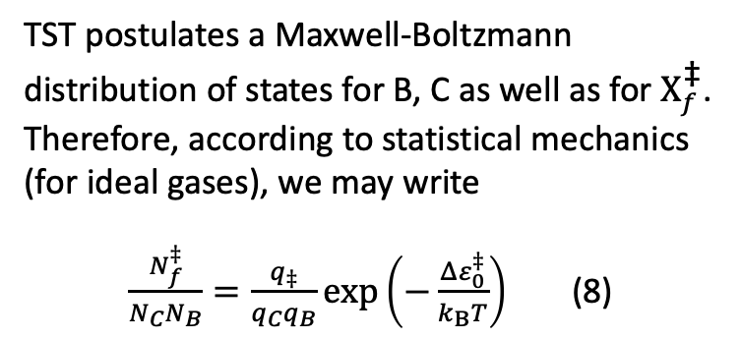
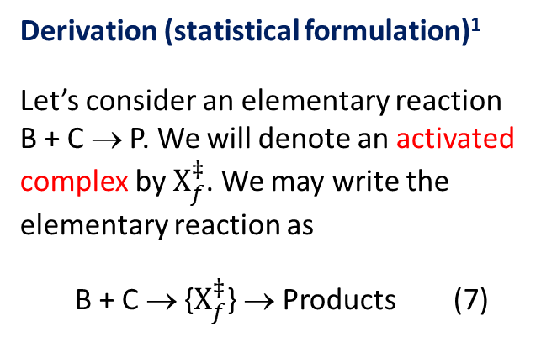
Transition State Theory Statistical Formulation
Derivation (statistical formulation)¹
Let’s consider an elementary reaction B + C → P. We will denote an activated complex by $X_{f}^{‡}$. We may write the elementary reaction as
B + C → {$X_{f}^{‡}$} → Products (7)
v_{s}
Potential energy
$$Δε_{0}^{\text{‡}}$$
ZPE
TST postulates a Maxwell-Boltzmann distribution of states for B, C as well as for $X_{f}^{\text{‡}}$. Therefore, according to statistical mechanics (for ideal gases), we may write
$\frac{N_{f}^{‡}}{N_{C}N_{B}}=\frac{q_{‡}}{q_{C}q_{B}}exp⁡\left(−\frac{Δε_{0}^{‡}}{k_{B}T}\right)$ (8)
Reactants
Products
$$−\frac{δ}{2} 0 \frac{δ}{2}$$
Reaction coordinate, s
where N denotes number of molecules, q, molecular partition functions and $k_{B}$ is the Boltzmann constant.
This presentation follows I. N. Levine, Physical Chemistry, 6th ed. McGraw-Hill (2009).
(Statistical) Reaction Rate Theories
Notes:
double dagger symbol
Activated complex: any supermolecule whose nuclear configuration corresponds to a point on the dividing Surface
The curly brackets indicate that the activated complex is a transient species, not a reaction intermediate.

Slide 5
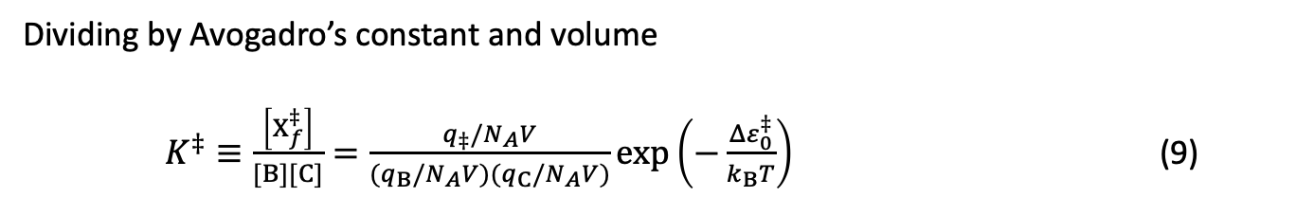
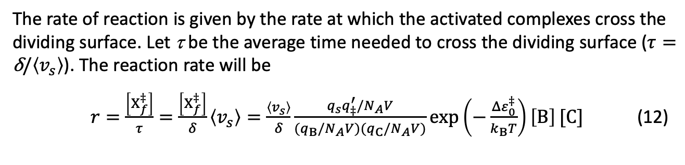
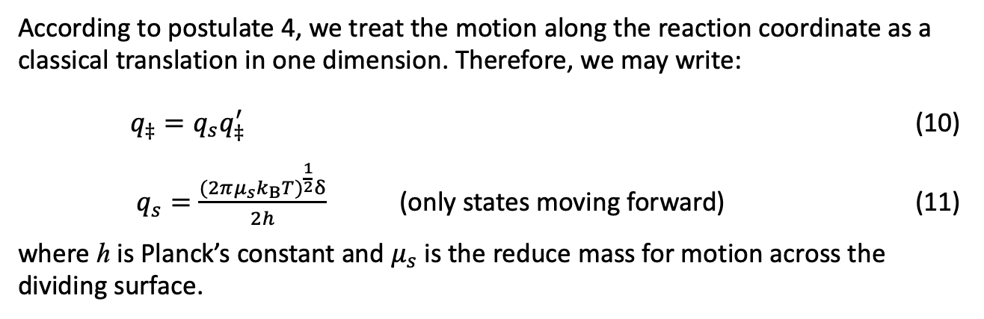
Transition State Theory Statistical Formulation
Dividing by Avogadro’s constant and volume
$K^{‡}≡\frac{\left[X_{f}^{‡}\right]}{[B][C]}=\frac{q_{‡}/N_{A}V}{{(q}_{B}/N_{A}V){(q}_{C}/N_{A}V)}exp⁡\left(−\frac{Δε_{0}^{‡}}{k_{B}T}\right)$ (9)
According to postulate 4, we treat the motion along the reaction coordinate as a classical translation in one dimension. Therefore, we may write:
$q_{‡}=q_{s}q_{‡}^{′}$ (10)
$q_{s}=\frac{{(2πμ_{s}k_{B}T)}^{\frac{1}{2}}δ}{2h}$ (only states moving forward) (11)
where h is Planck’s constant and $μ_{s}$ is the reduce mass for motion across the dividing surface.
The rate of reaction is given by the rate at which the activated complexes cross the dividing surface. Let τ be the average time needed to cross the dividing surface ($τ=\text{δ}\text{/}\left\langle v_{s}\right\rangle$). The reaction rate will be
$r=\frac{\left[X_{f}^{‡}\right]}{τ}=\frac{\left[X_{f}^{‡}\right]}{δ}\left\langle v_{s}\right\rangle =\frac{\left\langle v_{s}\right\rangle }{δ}\frac{q_{s}q_{‡}^{′}/N_{A}V}{{(q}_{B}/N_{A}V){(q}_{C}/N_{A}V)}\exp\left(−\frac{Δε_{0}^{‡}}{k_{B}T}\right)\left[B\right][C]$ (12)
(Statistical) Reaction Rate Theories

Slide 6
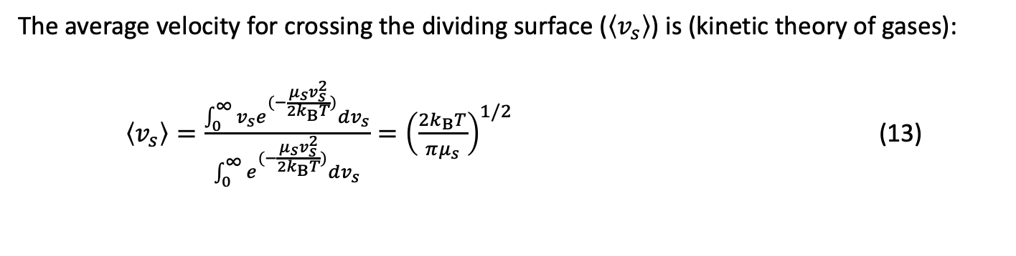
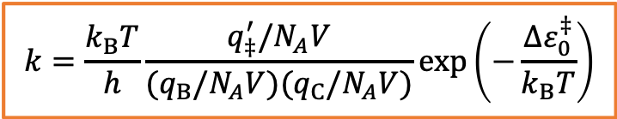
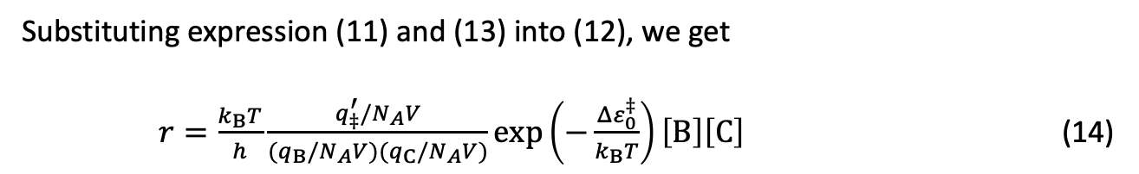
Transition State Theory Statistical Formulation
The average velocity for crossing the dividing surface ($\left\langle v_{s}\right\rangle$) is (kinetic theory of gases):
$\left\langle v_{s}\right\rangle =\frac{\int_{0}^{∞}{v_{s}e^{(−\frac{μ_{s}v_{s}^{2}}{2k_{B}T})}dv_{s}}}{\int_{0}^{∞}{e^{(−\frac{μ_{s}v_{s}^{2}}{2k_{B}T})}dv_{s}}}={\left(\frac{2k_{B}T}{πμ_{s}}\right)}^{1/2}$ (13)
Substituting expression (11) and (13) into (12), we get
$r=\frac{k_{B}T}{h}\frac{q_{‡}^{′}/N_{A}V}{{(q}_{B}/N_{A}V){(q}_{C}/N_{A}V)}\exp\left(−\frac{Δε_{0}^{‡}}{k_{B}T}\right)\left[B\right]\left[C\right]$ (14)
And since r = k[B][C], we finally obtain for the rate constant k
(15)
$$k=\frac{k_{B}T}{h}\frac{q_{‡}^{′}/N_{A}V}{{(q}_{B}/N_{A}V){(q}_{C}/N_{A}V)}\exp\left(−\frac{Δε_{0}^{‡}}{k_{B}T}\right)$$
Units: unimolecular: s⁻¹
bimolecular: M ⁻¹ s⁻¹ (if the molecular partition functions are not divided by N_{A}, the units are cm³·molecule⁻¹·s⁻¹).
(Statistical) Reaction Rate Theories
Notes:
We use the distribution of velocities in one direction known from the kinetic theory of gases.

Slide 7
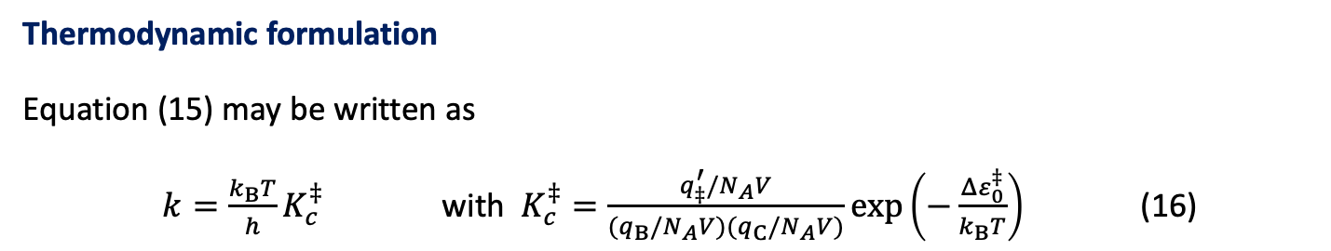
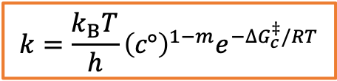
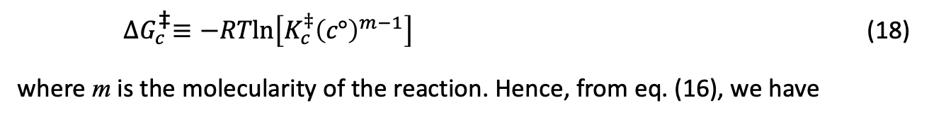
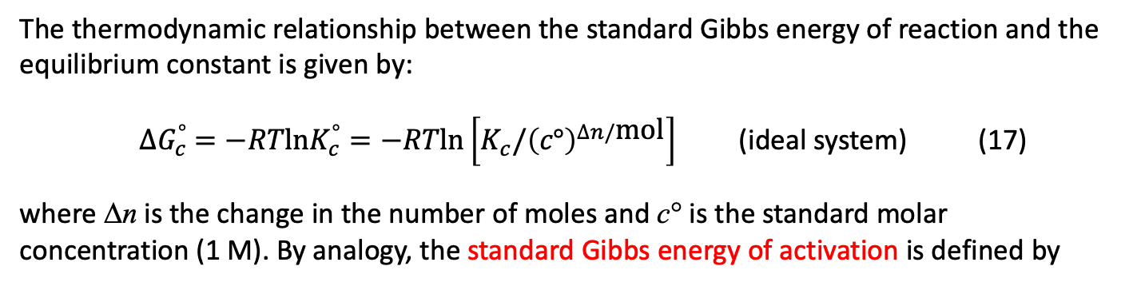
Transition State Theory Thermodynamic formulation
Thermodynamic formulation
Equation (15) may be written as
$k=\frac{k_{B}T}{h}K_{c}^{‡}$ with $K_{c}^{‡}=\frac{q_{‡}^{′}/N_{A}V}{{(q}_{B}/N_{A}V){(q}_{C}/N_{A}V)}\exp\left(−\frac{Δε_{0}^{‡}}{k_{B}T}\right)$ (16)
The thermodynamic relationship between the standard Gibbs energy of reaction and the equilibrium constant is given by:
${∆G}_{c}^{°} =−RT\text{ln}K_{c}^{°}=−RTln\left[K_{c}/{\left(c°\right)}^{∆n/\text{mol}}\right]$ (ideal system) (17)
where Δn is the change in the number of moles and c° is the standard molar concentration (1 M). By analogy, the standard Gibbs energy of activation is defined by
${∆G}_{c}^{\text{‡}}≡−RTln\left[K_{c}^{‡}{\left(c°\right)}^{m−1}\right]$ (18)
where m is the molecularity of the reaction. Hence, from eq. (16), we have
$$k=\frac{k_{B}T}{h}{\left(c°\right)}^{1−m}e^{−{∆G}_{c}^{‡}/RT}$$
(concentration scale) (19)
(Statistical) Reaction Rate Theories
Notes:
Comentar que con la ecuación 19 podemos calcular fácilmente la constante de velocidad, mediante la diferencia entre la energía libre del TS y la de los reactivos.

Slide 8
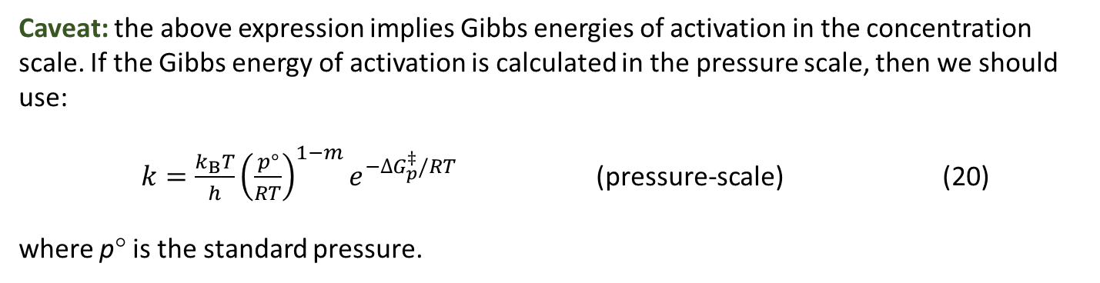
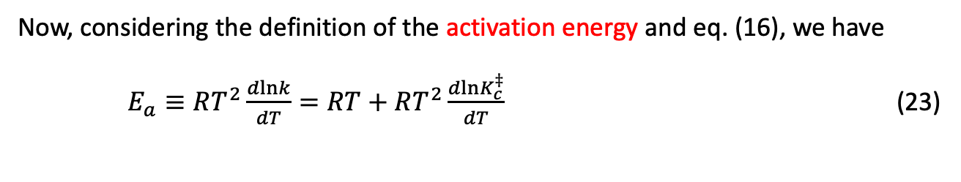
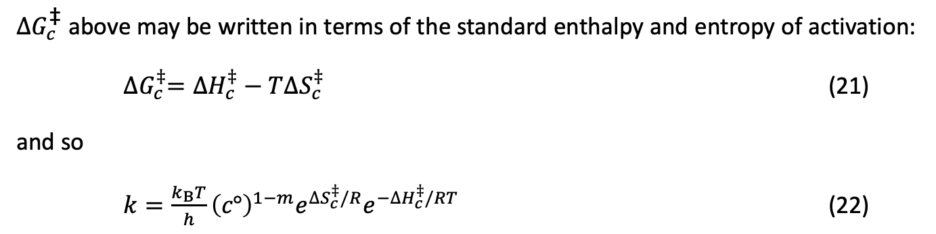
Transition State Theory Thermodynamic formulation
Caveat: the above expression implies Gibbs energies of activation in the concentration scale. If the Gibbs energy of activation is calculated in the pressure scale, then we should use:
$k=\frac{k_{B}T}{h}{\left(\frac{p°}{RT}\right)}^{1−m}e^{−{∆G}_{p}^{‡}/RT}$ (pressure-scale) (20)
where p° is the standard pressure.
Arrhenius parameters and thermodynamic quantities of activation: relationship
${∆G}_{c}^{\text{‡}}$above may be written in terms of the standard enthalpy and entropy of activation:
${∆G}_{c}^{‡}={∆H}_{c}^{‡}−T{∆S}_{c}^{‡}$ (21)
and so
$k=\frac{k_{B}T}{h}{\left(c°\right)}^{1−m}{e^{{∆S}_{c}^{‡}/R}e}^{−{∆H}_{c}^{‡}/RT}$ (22)
Now, considering the definition of the activation energy and eq. (16), we have
$E_{a}≡RT^{2}\frac{dlnk}{dT}=RT+RT^{2}\frac{dlnK_{c}^{‡}}{dT}$ (23)
(Statistical) Reaction Rate Theories
Notes:
Indicate that in Gaussian, free energies are calculated in the pressure scale.
In the pressure scale q_trans is not divided by V. This is the difference. Molar volume is RT/p0, which is the factor that apperar in the pressure scale.
The difference is in the q_trans. In Gaussian the V is the volume of one molecule (in k_p q/N appears and so N cancels).
In the concentration-scale, delta_G a V appears in the denominator of q_trans (and V cancels) and the factor (p0/kBT)**(1-m) appears in the eq.

Slide 9
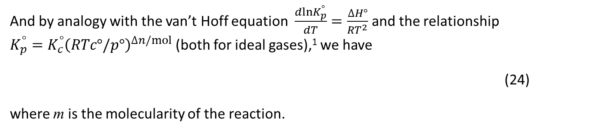
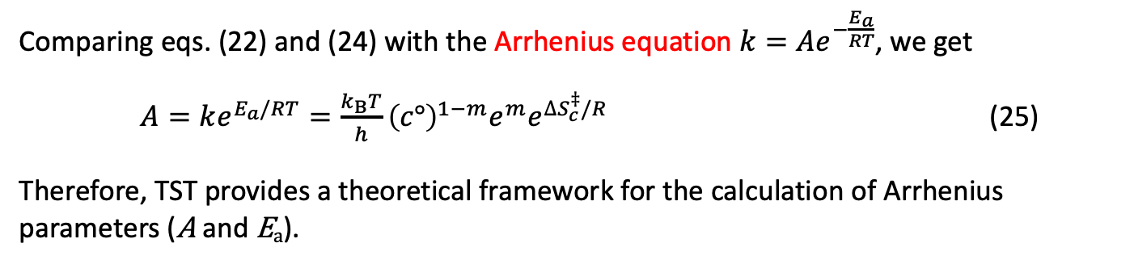
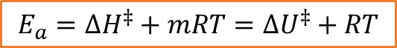
Transition State Theory Thermodynamic formulation
And by analogy with the van’t Hoff equation $\frac{dlnK_{p}^{°}}{dT}=\frac{∆H°}{RT^{2}}$ and the relationship $K_{p}^{°}={K_{c}^{°}\left(RTc°/p°\right)}^{∆n/mol}$ (both for ideal gases),¹ we have
(24)
where m is the molecularity of the reaction.
$$E_{a}=∆H^{‡}+mRT=∆U^{‡}+RT$$
Comparing eqs. (22) and (24) with the Arrhenius equation $k=Ae^{−\frac{E_{a}}{RT}}$, we get
$A=ke^{E_{a}/RT}=\frac{k_{B}T}{h}{\left(c°\right)}^{1−m}e^{m}e^{∆S_{c}^{‡}/R}$ (25)
Therefore, TST provides a theoretical framework for the calculation of Arrhenius parameters (A and E_{a}).
Remark: A common mistake is to think that E_{a} is equal to the energy barrier to reaction ($Δε_{0}^{‡}$). They are not the same quantity!
For details, see I. N. Levine, Physical Chemistry, 6th ed. McGraw-Hill (2009).
(Statistical) Reaction Rate Theories
Notes:
Regarding eq 25, for ideal gases: $∆H^{‡}+mRT=∆U^{‡}+∆(pV)+mRT=∆U^{‡}+RT$

Slide 10
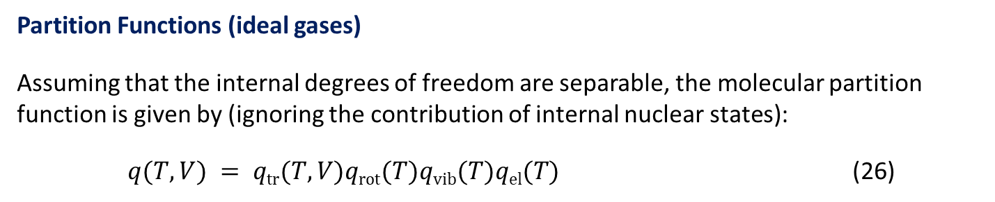
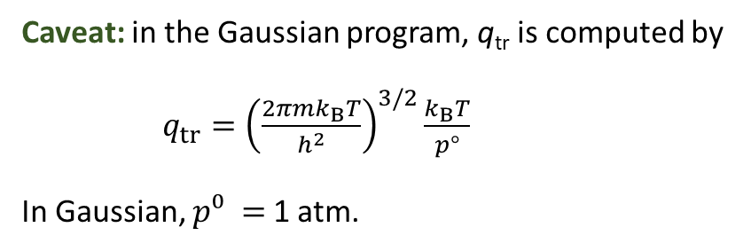
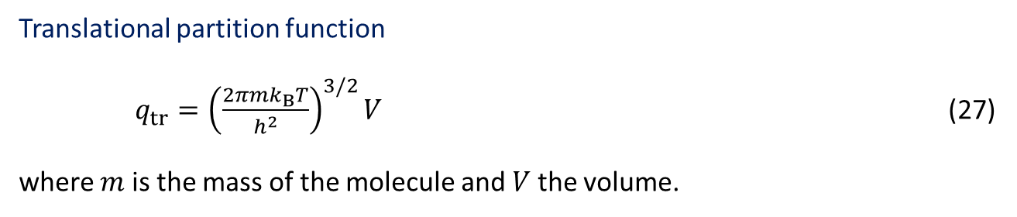
Transition State Theory Partition Functions
Partition Functions (ideal gases)
Assuming that the internal degrees of freedom are separable, the molecular partition function is given by (ignoring the contribution of internal nuclear states):
$q(T,V) = q\text{tr}(T,V)q\text{rot}(T)q\text{vib}(T)q\text{el}(T)$ (26)
Translational partition function
$q_{tr}={\left(\frac{2πmk_{B}T}{h^{2}}\right)}^{3/2}V$ (27)
where $m$ is the mass of the molecule and$V$the volume.
Caveat: in the Gaussian program, q_{tr} is computed by
$q_{tr}={\left(\frac{2πmk_{B}T}{h^{2}}\right)}^{3/2}\frac{k_{B}T}{p°}$
In Gaussian, $p⁰ =$1 atm.
(Statistical) Reaction Rate Theories
Notes:
Gaussian’s formula leads to the pressure-scale deltaG calculation.
In the concentration scale, qtr is divided by the V, and the term kT/p0 dissapears

Slide 11
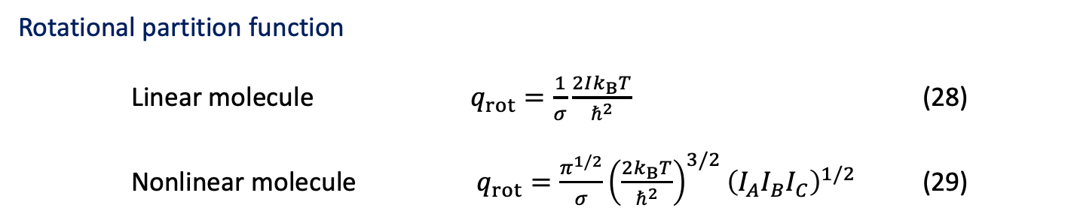
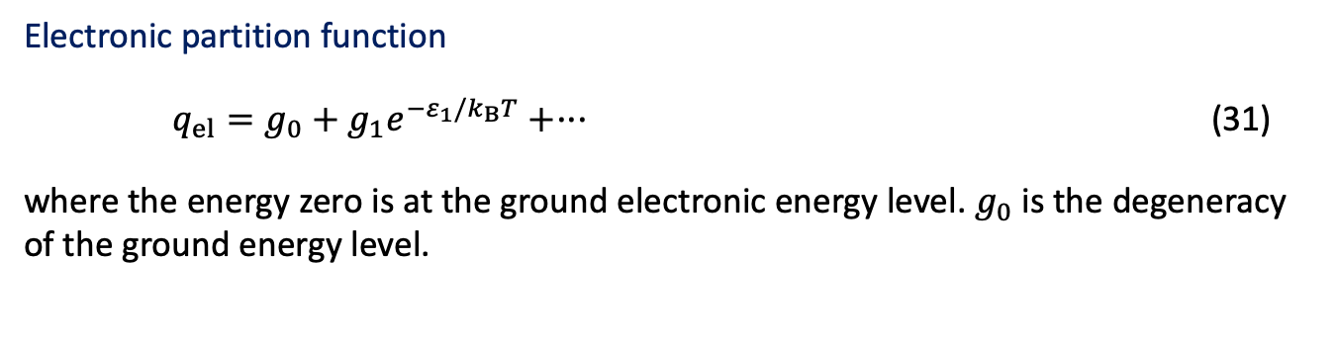
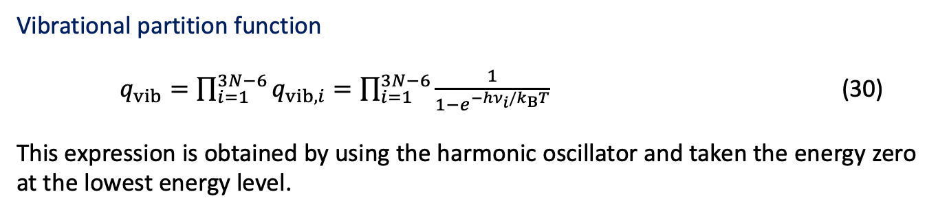
Transition State Theory Partition Functions
Rotational partition function
Linear molecule $q_{rot}=\frac{1}{σ}\frac{2Ik_{B}T}{ℏ^{2}}$ (28)
Nonlinear molecule $q_{rot}=\frac{π^{1/2}}{σ}{\left(\frac{2k_{B}T}{ℏ^{2}}\right)}^{3/2}{\left(I_{A}I_{B}I_{C}\right)}^{1/2}$ (29)
Vibrational partition function
$q_{vib}=\prod_{i=1}^{3N−6}{q_{vib,i}}=\prod_{i=1}^{3N−6}{\frac{1}{1−e^{−hν_{i}/k_{B}T}}}$ (30)
This expression is obtained by using the harmonic oscillator and taken the energy zero at the lowest energy level.
Electronic partition function
$q_{el}=g_{0}+g_{1}e^{−ε_{1}/k_{B}T}+···$ (31)
where the energy zero is at the ground electronic energy level. $g_{0}$is the degeneracy of the ground energy level.
(Statistical) Reaction Rate Theories

Slide 12
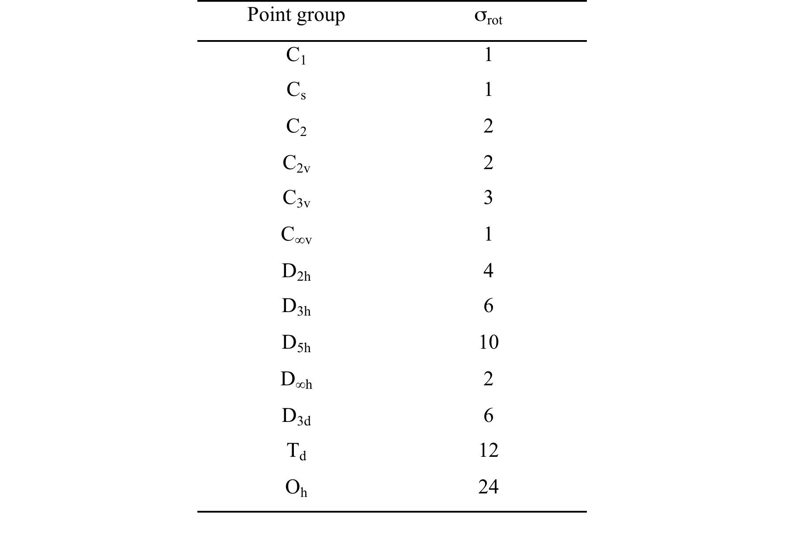
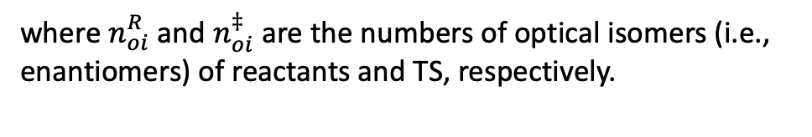
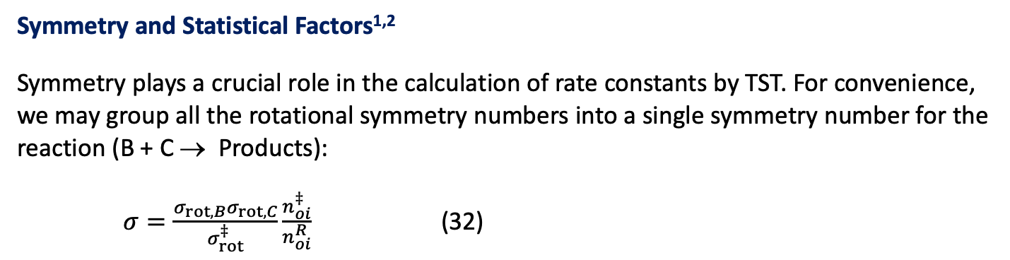
Transition State Theory Symmetry and Statistical Factors
Symmetry and Statistical Factors^{1,2}
Symmetry plays a crucial role in the calculation of rate constants by TST. For convenience, we may group all the rotational symmetry numbers into a single symmetry number for the reaction (B + C → Products):
$σ=\frac{σ_{rot,B}σ_{rot,C}}{σ_{rot}^{‡}}\frac{n_{oi}^{‡}}{n_{oi}^{R}}$ (32)
where $n_{oi}^{R}$ and $n_{oi}^{‡}$are the numbers of optical isomers (i.e., enantiomers) of reactants and TS, respectively.
E. Pollack and P. J. Pechukas, J. Am. Chem. Soc. 100, 2984 (1978)
A. Fernández-Ramos, B. A. Ellingson, R. Meana-Pañeda, J. C. Marques, D. G. Truhlar, Theor. Chem. Acc. 118, 813 (2007)
(Statistical) Reaction Rate Theories

Slide 13
Transition State Theory Symmetry and Statistical Factors
Example 1: Reaction without optical isomers.
CF₃ + CH₄ → CF₃H + CH₃
(Statistical) Reaction Rate Theories: Theo-2

Slide 14
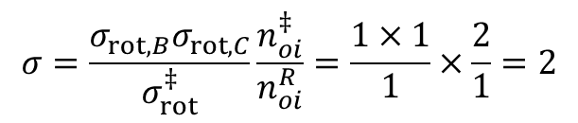
Transition State Theory Symmetry and Statistical Factors
Example 2: Reaction with optical isomers.
H + CH₃OH → H₂ + CH₂OH
TS1
TS1*
TS
$$σ=\frac{σ_{rot,B}σ_{rot,C}}{σ_{rot}^{‡}}\frac{n_{oi}^{‡}}{n_{oi}^{R}}=\frac{1×1}{1}×\frac{2}{1}=2$$
Reactant
The TST thermal rate constant should be multiplied by 2.
(Statistical) Reaction Rate Theories

Slide 15
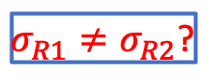
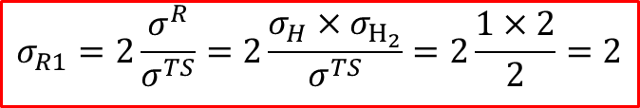
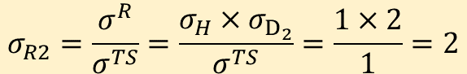
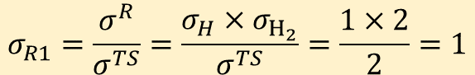
Transition State Theory Symmetry and Statistical Factors
Example 3: Symmetric Reactions.
R1: H + H₂ → H⋅⋅⋅⋅⋅H⋅⋅⋅⋅⋅H → H₂ + H
$$σ_{R1}=\frac{σ^{R}}{σ^{TS}}=\frac{σ_{H}×σ_{H_{2}}}{σ^{TS}}=\frac{1×2}{2}=1$$
R2: H + D₂ → H⋅⋅⋅⋅⋅D⋅⋅⋅⋅⋅D → HD + H
$$σ_{R2}=\frac{σ^{R}}{σ^{TS}}=\frac{σ_{H}×σ_{D_{2}}}{σ^{TS}}=\frac{1×2}{1}=2$$
$σ_{R1}≠σ_{R2}$?
¿What is happening?
TST rate constant: is the forward flux (from reactants to products of molecules) crossing the dividing surface.
However, for R1 reactants and products are the same, so the total rate constant should be multiplied by 2.
$$σ_{R1}=2\frac{σ^{R}}{σ^{TS}}=2\frac{σ_{H}×σ_{H_{2}}}{σ^{TS}}=2\frac{1×2}{2}=2$$
H+H₂
H₂+H
The same rule applies to unimolecular reactions, e.g. proton transfer reaction in malonaldehyde
(Statistical) Reaction Rate Theories

Slide 16
Transition State Theory Discussion of the Main Assumptions
The quasi-equilibrium assumption
According to postulates 2 and 3 (the latter is sometimes considered as a consequence of postulate 2), the states of reactants and activated complexes are in thermal equilibrium during the reaction.
In general, this assumption is valid for most bimolecular reactions (gas-phase and solution) because the inelastic collisions efficiently repopulate the reactant rovibrational states, maintaining the Boltzmann distribution.
For gas-phase unimolecular reactions at low pressures, the quasi-equilibrium assumption breaks down and the rate constants become pressure dependent. TST gives the high-pressure limit.
Graph from I. N. Levine, Physical Chemistry, 6th ed. McGraw-Hill (2009).
(Statistical) Reaction Rate Theories
Notes:
The value of the asymptote in this plot

Slide 17
Transition State Theory Discussion of the Main Assumptions
Quantum effects
We have mixed classical mechanics with quantum mechanics (use of harmonic oscillator energy levels for the vibrational partition function). This “quasi-classical” approach may be very inaccurate for reactions involving very light species (H or D atoms), where tunnelling may be significant (particularly at low and moderate temperatures). We need to incorporate quantum effects into the reaction coordinate.
Anharmonic effects
We used the harmonic oscillator as a model for molecular vibrations. Depending on the nature of reactants and TS, and on the temperature, the inclusion of anharmonic corrections may be important.
Separability of the reaction coordinate
When the reaction coordinate is significantly coupled to other degrees of freedom, this assumption may lead to inaccuracies in the calculation of rate constants.
(Statistical) Reaction Rate Theories

Slide 18
Transition State Theory Discussion of the Main Assumptions
The no-recrossing approximation
Depending on the shape of the PES, the no-recrossing approximation may fail dramatically.
Reactants
Products
1
TS
“Tight” transition state
4
2
Potential energy
5
Products
Reactant
Reaction coordinate
3
“Loose” transition states
Products
6
Variational TST
Potential energy
Reactant
DS1
DS2
Reaction coordinate
Adapted from Steinfeld, Francisco, Hase. Chemical Kinetics and Dynamics, 2nd ed. Prentice-Hall, Inc. (1999)
Classical TST gives an upper bound to the correct classical rate constant!
(Statistical) Reaction Rate Theories
Notes:
There are six crossings of the TS in the direction from reactants to products, and TST counts all of them as contributing to the reactive flux.
“Correlated motion”

Slide 19
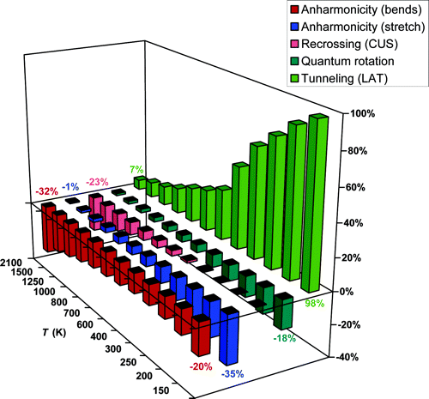
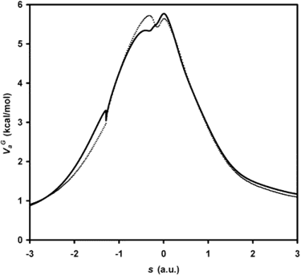
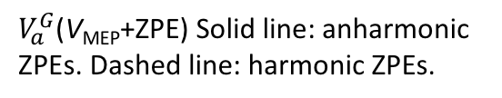
Transition State Theory Discussion of the Main Assumptions
Example: The H₂ + Cl hydrogen abstraction reaction¹
Percentage change in the rate constants upon including anharmonicity, recrossing, quantum rotational partition functions and tunneling.
$V_{a}^{G}$(V_{MEP}+ZPE) Solid line: anharmonic ZPEs. Dashed line: harmonic ZPEs.
¹ J. A. Sansón, M.L. Sánchez and J. C. Corchado, J. Phys Chem. A 110, 589 (2006).
(Statistical) Reaction Rate Theories
Notes:
To close the discussion on the main assumptions of TST, we have this interesting example: the hydrogen abstraction in the reaction of chlorine atom with molecular hydrogen.

Slide 20
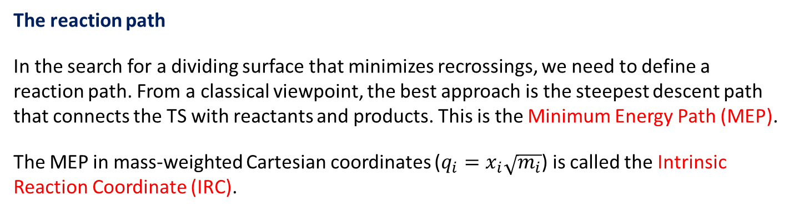
Improvements and Extensions Variational Transition State Theory
The reaction path
In the search for a dividing surface that minimizes recrossings, we need to define a reaction path. From a classical viewpoint, the best approach is the steepest descent path that connects the TS with reactants and products. This is the Minimum Energy Path (MEP).
The MEP in mass-weighted Cartesian coordinates ($q_{i}=x_{i}\sqrt{m_{i}}$) is called the Intrinsic Reaction Coordinate (IRC).
alternative dividing
surface
The reaction coordinate, or progression along the path (s), defines the position along the MEP: s = 0 at TS, s < 0 for the reactant side and s > 0 for the product side.
Dividing surfaces are orthogonal to the reaction path and, therefore, to the gradient.
V ‡
Energy
♦
♦
TST dividing
surface
V_{MEP}(s)
s<0
s>0
Reactants
0
Products
Reaction coordinate, s
(Statistical) Reaction Rate Theories
Notes:
We want to find a dividing surface that minimizes the recrossings. To this end, we define the reaction path...

Slide 21
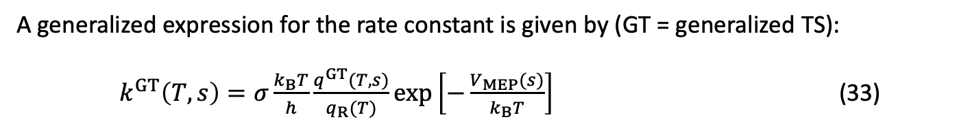
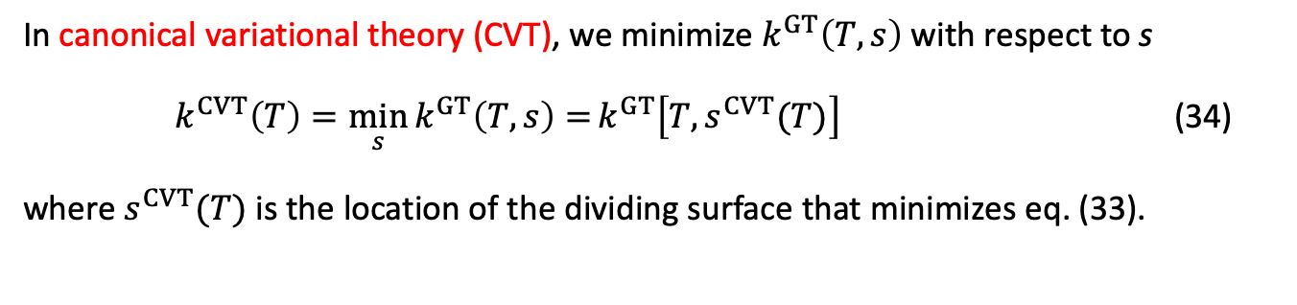
Improvements and Extensions Variational Transition State Theory
In variational transitions state theory (VTST), the position of the dividing surface is optimized to minimize recrossings.¹
A generalized expression for the rate constant is given by (GT = generalized TS):
$k^{GT}\left(T,s\right)=σ\frac{k_{B}T}{h}\frac{q^{GT}(T,s)}{q_{R}(T)}exp\left[−\frac{V_{MEP}(s)}{k_{B}T}\right]$ (33)
Caveats: in VTST, it is customary to use:
translational partition functions per volume (i.e., q_{tr} is divided by V).
“number” density instead of molar concentrations (see “units” after eq. 15).
energy zero at the bottom of the potential well for q_{vib}. V_{MEP}(s) does not include ZPE corrections.
In canonical variational theory (CVT), we minimize $k^{GT}\left(T,s\right)$with respect to s
${k^{CVT}\left(T\right)=\min_{s}{k^{GT}\left(T,s\right)=}k}^{GT}\left[T,s^{CVT}(T)\right]$ (34)
where $s^{CVT}(T)$ is the location of the dividing surface that minimizes eq. (33).
E. Wigner, J. Chem. Phys. 5, 720, (1937); J. Horiuti, Bull. Chem. Soc. Japan 13, 210 (1938); J. C. Keck, J. Chem. Phys. 32, 1035 (1960); D. G. Truhlar and B. C. Garrett, Annu. Rev. Phys. Chem. 35, 159 (1984).
(Statistical) Reaction Rate Theories

Slide 22
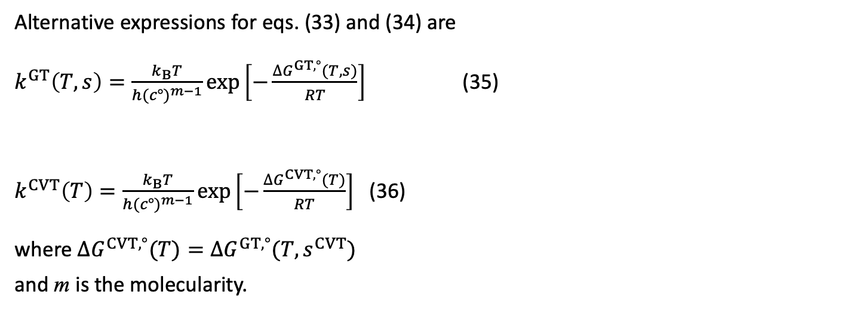
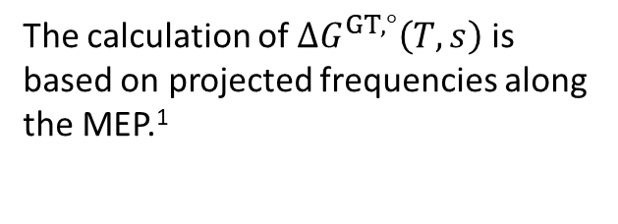
Improvements and Extensions Variational Transition State Theory
Alternative expressions for eqs. (33) and (34) are
$k^{GT}\left(T,s\right)=\frac{k_{B}T}{h{(c°)}^{m−1}}exp\left[−\frac{∆G^{GT,°}(T,s)}{RT}\right]$ (35)
$k^{CVT}\left(T\right)=\frac{k_{B}T}{h{(c°)}^{m−1}}exp\left[−\frac{∆G^{CVT,°}(T)}{RT}\right]$ (36)
where $∆G^{CVT,°}(T)=∆G^{GT,°}({T,s}^{CVT})$
and m is the molecularity.
Canonical VTST (CVT) is the most common version of VTST.
ΔG^{CVT,o}(T)
♦
ΔG^{‡,o}(T)
♦
ΔG^{GT,o}(T,s)
CVT dividing
surface
V ‡
Energy
♦
The calculation of $∆G^{GT,°}\left(T,s\right)$ is based on projected frequencies along the MEP.¹
♦
TST dividing
surface
V_{MEP}(s)
0
s<0
s>0
Reactants
s^{CVT}(T)
0
Products
Reaction coordinate, s
Y.-Y. Chuang and D. G. Truhlar, J. Phys. Chem. A, 102, 242 (1998).
(Statistical) Reaction Rate Theories

Slide 23
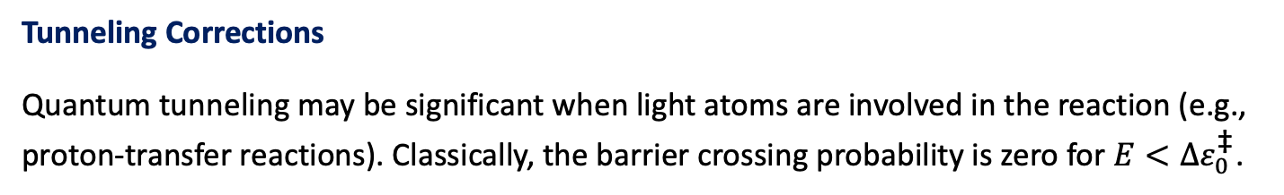
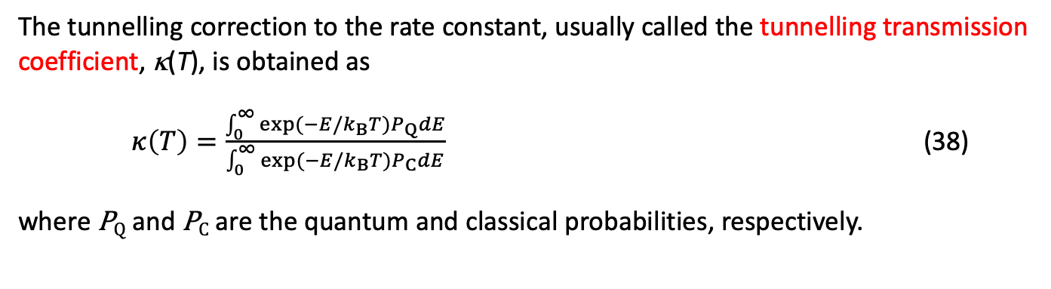
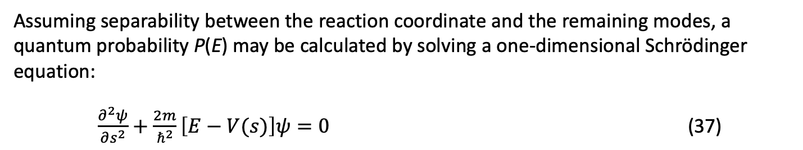
Improvements and Extensions Tunneling Corrections
Tunneling Corrections
Quantum tunneling may be significant when light atoms are involved in the reaction (e.g., proton-transfer reactions). Classically, the barrier crossing probability is zero for $E<Δε_{0}^{\text{‡}}$.
Assuming separability between the reaction coordinate and the remaining modes, a quantum probability P(E) may be calculated by solving a one-dimensional Schrödinger equation:
$\frac{∂^{2}ψ}{∂s^{2}}+\frac{2m}{ℏ^{2}}\left[E−V(s)\right]ψ=0$ (37)
The tunnelling correction to the rate constant, usually called the tunnelling transmission coefficient, κ(T), is obtained as
$κ\left(T\right)=\frac{\int_{0}^{∞}{exp(−E/k_{B}T})P_{Q}dE}{\int_{0}^{∞}{exp(−E/k_{B}T})P_{C}dE}$ (38)
where P_{Q} and P_{C} are the quantum and classical probabilities, respectively.
(Statistical) Reaction Rate Theories

Slide 24
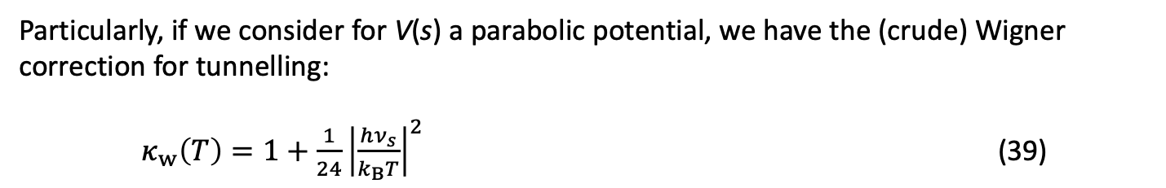
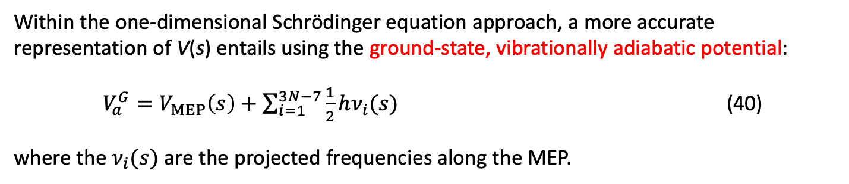
Improvements and Extensions Tunneling Corrections
Particularly, if we consider for V(s) a parabolic potential, we have the (crude) Wigner correction for tunnelling:
$κ_{w}\left(T\right)=1+\frac{1}{24}{\left|\frac{hν_{s}}{k_{B}T}\right|}^{2}$ (39)
Within the one-dimensional Schrödinger equation approach, a more accurate representation of V(s) entails using the ground-state, vibrationally adiabatic potential:
$V_{a}^{G}=V_{MEP}\left(s\right)+\sum_{i=1}^{3N−7}{\frac{1}{2}hν_{i}(s)}$ (40)
where the $ν_{i}(s)$ are the projected frequencies along the MEP.
The one-dimensional approach is, in general, a very poor approximation, and more accurate treatments must include the couplings with the internal degrees of freedom. The calculation of multidimensional tunnelling transmission coefficients are carried out by using semiclassical methods.¹
¹ A. Fernández-Ramos, B. A. Ellingson, B. C. Garrett and Donald G. Truhlar, in Reviews in Computational Chemistry, Vol. 23, ed., John Wiley & Sons, Inc., Hoboken, NJ (2007).
(Statistical) Reaction Rate Theories

Slide 25
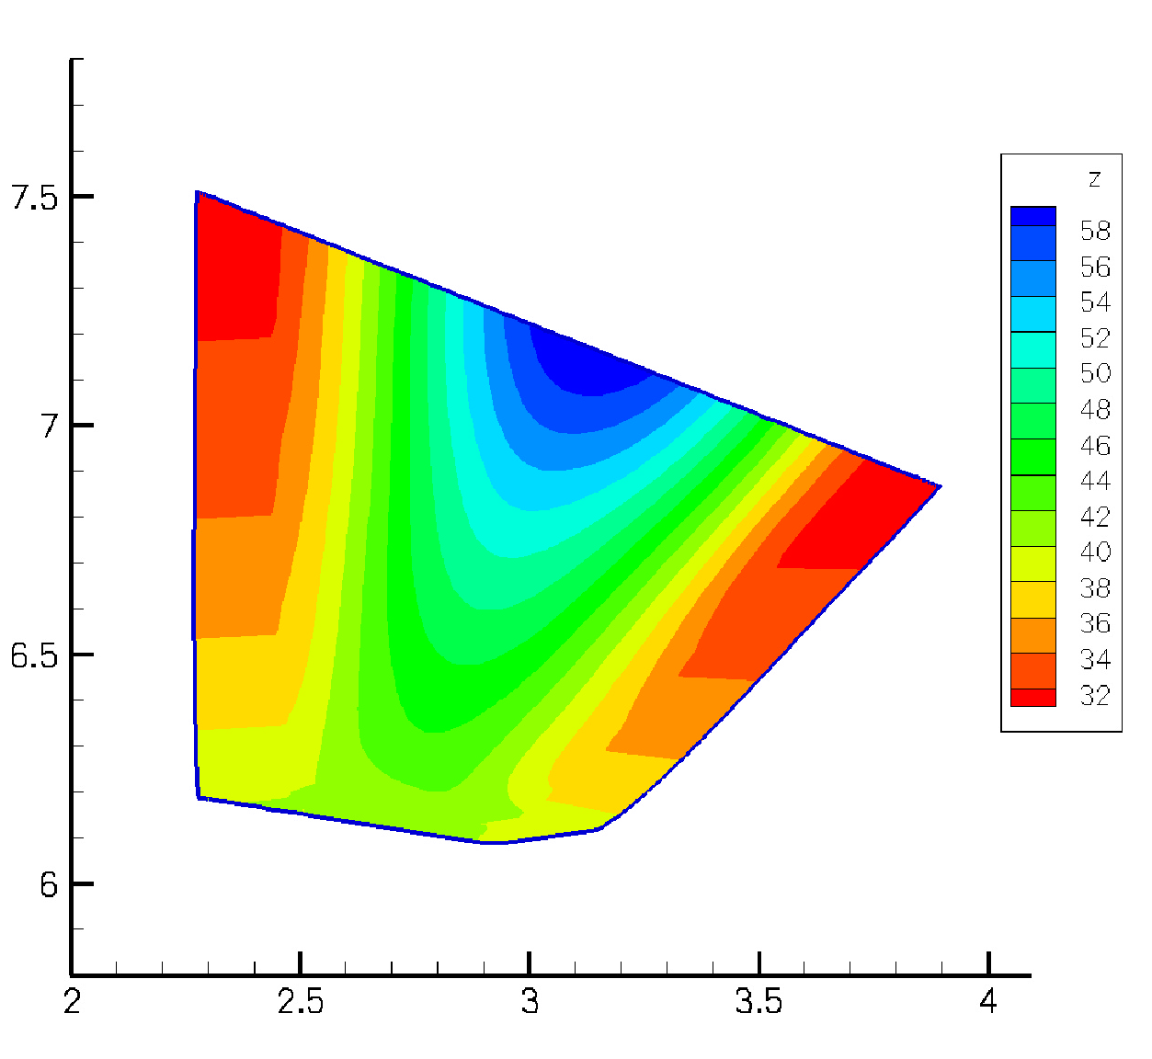
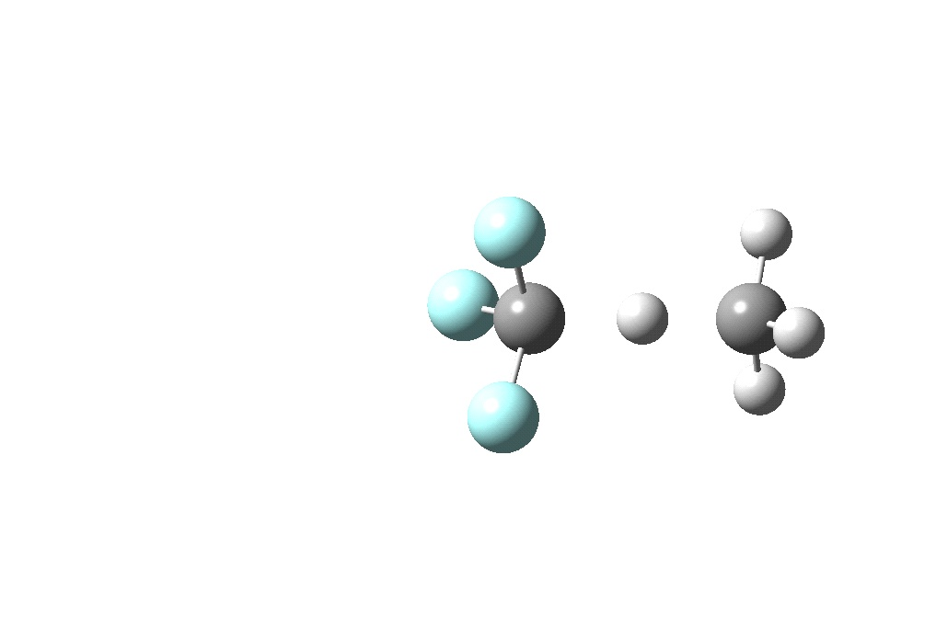
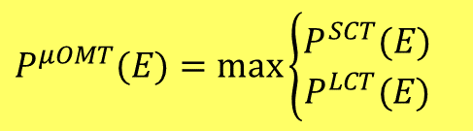
Improvements and Extensions Tunneling Corrections
Multidimensional transmission coefficients ( κ^{CVT/X})
Energy (in kcal/mol)
SCT: small-curvature transmission coefficients: accurate if the tunneling effect is not very important.
Tunneling energy
Straight path
LCT
LCT: large-curvature transmission coefficients: accurate if tunneling is large.
Motion of the heavy atoms (a₀)
LAT
LAT: least-action transmission coefficients. Quite reliable but very expensive from the computational point of view.
SCT
MEP
TS
Microcanonically-optimized probability
Hydrogen motion (a₀)
$$P^{μOMT}(E)=\max\left\{\begin{matrix}P^{SCT}(E) \\ P^{LCT}(E)\end{matrix}\right.$$
(Statistical) Reaction Rate Theories
Notes:
There are several approaches for calculating multidimensional transmisión coefficients. Here we have the names of common methods but I will not enter into details.

Slide 26
Improvements and Extensions
Dependence of k on temperature: range of applicability of VTST
VTST/MT
Variational transition state theory
High-temperature regime
Classical region k=Aexp(-E_{a}/RT) Arrhenius behaviour
400-500K
log k(T)
Intermediate regime
Tunneling activated region
150-200K
Low-temperature regime
Quantum region
1/T
(Statistical) Reaction Rate Theories

Slide 27


Improvements and Extensions
Summary of Improvements
$$k^{CVT}\left(T\right)=\frac{k_{B}T}{h{(c°)}^{m−1}}exp\left[−\frac{∆G^{CVT,°}(T)}{RT}\right]=γ^{CVT}(T)k_{TST}(T)$$
$$γ^{CVT}\left(T\right)=Γ^{CVT}(T)κ^{CVT/X}(T)$$
The recrossing is minimized by variationally seeking dividing surfaces perpendicular to the MEP. The theory for calculating thermal rate constant in this way is called canonical variational transition state theory (CVT).
Quantum effects on the reaction coordinate are considered by including the couplings between the reaction coordinate and all the transverse modes. This leads to the canonical transition state theory with multidimensional tunneling CVT/X (X = ZCT, SCT, LCT, etc).
(Statistical) Reaction Rate Theories
Notes:
The CVT thermal rate constant may be expressed as the product of TST rate constant and a correction factor (γ), with accounts for variational and tunneling effects.

Slide 28

Improvements and Extensions Reactions with Several Conformers
Reactions with Several Conformers
Example: Thermal decomposition of the propanol radical.¹
Simplified schematic diagram of the main reaction pathways
D. Ferro-Costas et al., J. Phys. Chem. A 122, 4790 (2018).
(Statistical) Reaction Rate Theories

Slide 29








Improvements and Extensions Reactions with Several Conformers
CH₂CH₂CH₂OH → CH₂CH₂ + CH₂OH
Reactant conformers
PrOH_C_{γ}.01 (2)
PrOH_C_{γ}.02 (2)
PrOH_C_{γ}.03 (2)
PrOH_C_{γ}.04 (2)
PrOH_C_{γ}.05 (2)
Transition-state conformers
TS conformers
TS06.01 (2)
TS06.02 (2)
TS06.03 (2)
Reactant conformers
We define a conformational reaction channel (CRC) as the group of all paths, including specular images, that connect the rotamers of a given reactant with the associated TS rotameric species.
(Statistical) Reaction Rate Theories

Slide 30


Improvements and Extensions Reactions with Several Conformers
Multistructural Transition-State Theory (MS-TST)^{1,2}
Within the rigid-rotor, harmonic-oscillator approximation (RRHO), the partition function of a set of n_{C} reactant conformers is given by:
$q^{MS\text{−}HO}=\sum_{i=1}^{n_{C}}{m_{i}q_{i}^{RRHO}}$ (41)
where m_{i} = 2 if conformer i has an enantiomer, and m_{i} = 1 otherwise.
$q_{i}^{RRHO}$ is a joint RRHO partition function for conformer i
$q_{i}^{RRHO}=q_{rot,i}q_{vib,i}^{HO}e^{−U_{i}/kT}$ (42)
Energy zero: bottom of the potential energy well. The reactant conformers are sorted by increasing electronic energy, with U_{i} being the energy of the i-th conformation, relative to that of the lowest energy conformer.
The partition function of the set of n‡ TS conformers is defined in the same way.
J. L. Bao and D. G. Truhlar, Chem. Soc. Rev. 46, 7548 (2017).
D. Ferro-Costas et al., J. Phys. Chem. A 122, 4790 (2018).
(Statistical) Reaction Rate Theories

Slide 31


Improvements and Extensions Reactions with Several Conformers
The MS-TST rate constant is calculated as follows:
$k^{MS−TST}=B\frac{q^{MS\text{−}HO,‡}}{q^{MS\text{−}HO}}$ with $B=\frac{k_{B}T}{h}\frac{q_{el}^{‡}}{{Φ_{rel}q}_{el}}e^{−U^{‡}/kT}$ (43)
where${ U}^{‡}$ is the difference between the electronic energy of the lowest TS conformer and that of the lowest energy reactant conformer. $Φ_{rel}$is the partition function for the relative translational motion of reactants (unity for unimolecular reactions). It is an alternative way to express the quotient between the translational partition function of reactants and that of the transition state.
Alternatively, this MS-TST rate constant may also be written as a sum over all the individual rate constants that form the CRC:
$k^{MS\text{−}TST}=\sum_{i=1}^{n^{‡}}{m_{i}^{‡}k_{i}^{TST}}$ (44)
where
$k_{i}^{TST}=B\frac{q_{i}^{RRHO,‡}}{q^{MS\text{−}HO}}$ (45)
(Statistical) Reaction Rate Theories

Slide 32

Improvements and Extensions Reactions with Several Conformers
Multistructural (MS) and Multipath (MP) extensions in VTST
The above may be extended to VTST, by including tunnelling and variational effects:
$k^{MP\text{−}CVT/X}=\sum_{i=1}^{n^{‡}}{m_{i}^{‡}k_{i}^{CVT/X}=\sum_{i=1}^{n^{‡}}{m_{i}^{‡}γ_{i}^{CVT/X}k_{i}^{TST}}}$ (46)
with
$γ_{i}^{CVT/X}=Γ_{i}^{CVT}$ $κ_{i}^{CVT/X}$ (47)
If we assume that the variational and tunneling effects obtained from the MEP starting from the lowest-energy TS conformer are representative of these effects in the whole CRC, then we have the MS-CVT/X thermal rate constant.¹
For more details, see Ferro-Costas et al., J. Phys. Chem. A 122, 4790 (2018).
(Statistical) Reaction Rate Theories

Slide 33

Improvements and Extensions Reactions with Several Conformers
Example: Results for the thermal decomposition of the propanol radical.¹
Definition of the relevant CRCs and relative energies of the lowest energy conformers of the reactants and TSs.
D. Ferro-Costas et al., J. Phys. Chem. A 122, 4790 (2018).
(Statistical) Reaction Rate Theories

Slide 34

Improvements and Extensions Reactions with Several Conformers
Rate constants calculated at 1500 K
1W: one-well approach
MP: Multipath
(Statistical) Reaction Rate Theories

Slide 35

Improvements and Extensions Reactions with Several Conformers
Product branching ratios obtained starting from C·H₂CH₂CH₂OH and using MP (Solid lines) and 1W (dashed lines) rate constants.
(Statistical) Reaction Rate Theories

Slide 36
Further Reading
K. J. Laidler, Chemical Kinetics, Harper&Row (1987).
M. J. Pilling and P. W. Seakins, Reaction Kinetics, Oxford University Press (1996).
J. I. Steinfeld, J. S. Francisco and W. L. Hase, Chemical Kinetics and Dynamics, Prentice-Hall, Inc. (1999).
D. G. Truhlar, A. D. Isaacson and B. C. Garrett, “Generalized Transition State Theory”. In Theory of Chemical Reaction Dynamics, Vol. 3, M. Baer, ed., CRC Press, Boca Raton, FL, pp. 65 (1985).
A. Fernández-Ramos, B. A. Ellingson, B. C. Garrett and Donald G. Truhlar, “Variational Transition State Theory with Multidimensional Tunneling”. In Reviews in Computational Chemistry, Vol. 23, ed., John Wiley & Sons, Inc., Hoboken, NJ (2007).
J. L. Bao and D. G. Truhlar, “Variational Transition State Theory: Theoretical Framework and Recent Developments”. Chem. Soc. Rev., 46, 7548 (2017).
(Statistical) Reaction Rate Theories

